Slide 1
Entity Framework Debugging using SQL Server
A Detective Story

Slide 2

Story

Slide 3

Hello
Developer Advocate
At JetBrains

Slide 4
I am not a dba!

Slide 5
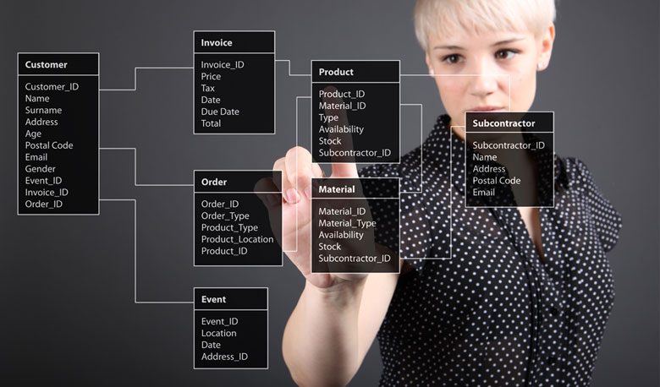
We are not going to attack DBA’s Here!

Slide 6

What we want to solve?

Slide 7
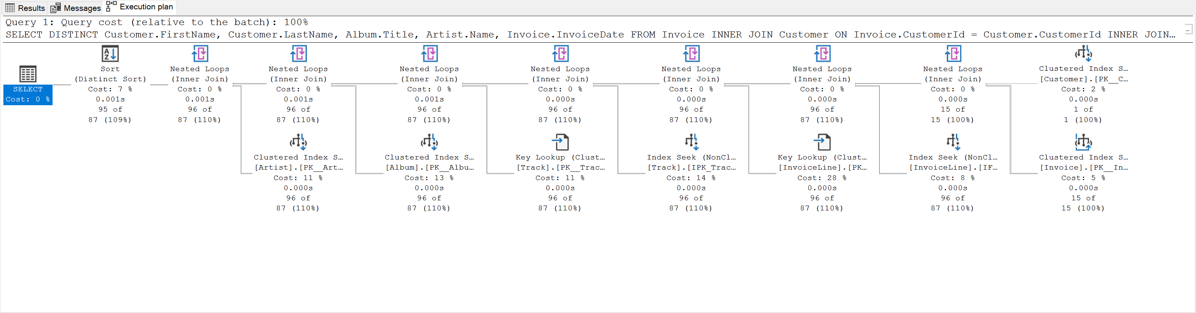
Detective Tip #1 – understand query Plans

Slide 8
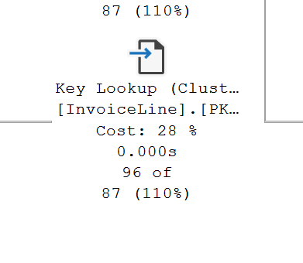
SELECT DISTINCT Customer.FirstName, Customer.LastName, Album.Title, Artist.Name, Invoice.InvoiceDate
FROM Invoice
INNER JOIN Customer ON Invoice.CustomerId = Customer.CustomerId
INNER JOIN InvoiceLine ON Invoice.InvoiceId = InvoiceLine.InvoiceId
INNER JOIN Track ON InvoiceLine.TrackId = Track.TrackId
INNER JOIN Album
INNER JOIN Artist ON Album.ArtistId = Artist.ArtistId ON Track.AlbumId = Album.AlbumId
WHERE Customer.CustomerId = 2
ORDER BY Album.Title

Slide 9
Detective Tip #2 – Finding your Least performing query
SELECT * FROM sys.dm_exec_query_stats
Worker Time
Physical Reads
Logical Writes
Logical Reads
SQLCLR Time
Elapsed Time
Row Count
Columns with aggregation information:
Total value
Last value
Min value
Max value

Slide 10
Finding your Least performing query
SELECT TOP 5
st.text,
qp.query_plan,
qs.*
FROM sys.dm_exec_query_stats qs
CROSS APPLY sys.dm_exec_sql_text(qs.plan_handle) st
CROSS APPLY sys.dm_exec_query_plan(qs.plan_handle) qp
ORDER BY total_worker_time DESC

Slide 11
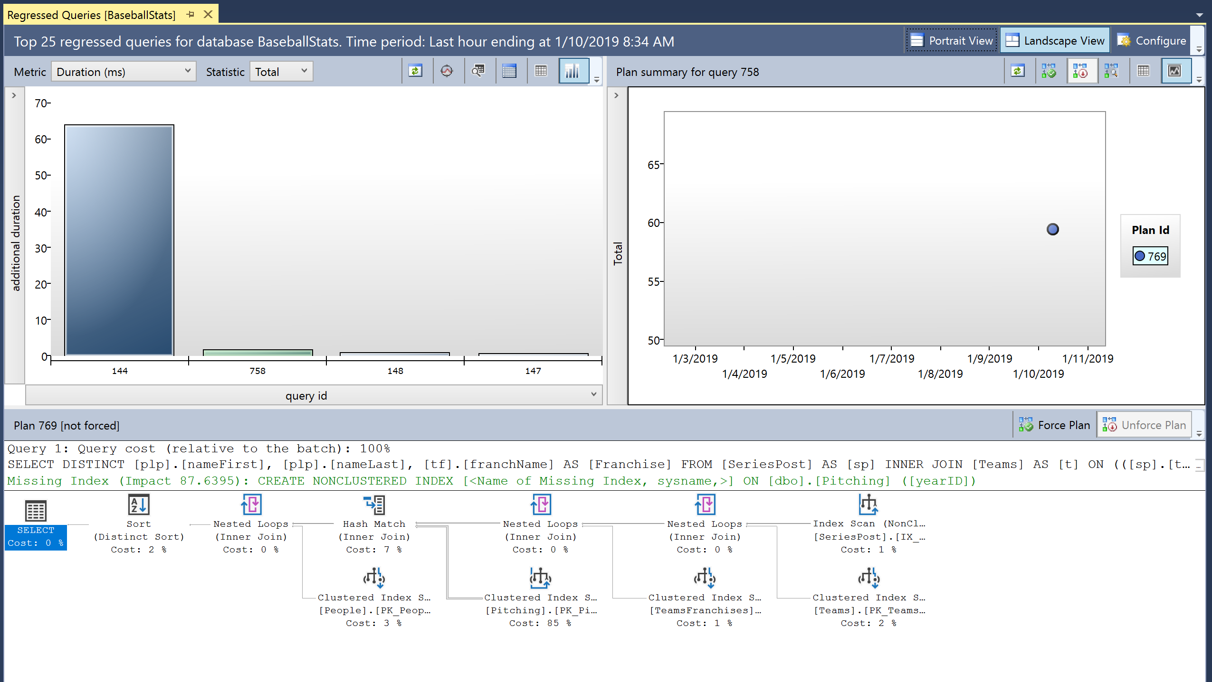
Detective Tip #3 – Learn about Query Store

Slide 12

Understanding the Query Store

Slide 13
Show how to enable Query Store
ALTER DATABASE AdventureWorks2017 SET QUERY_STORE = ON;

Slide 14

Detective Tip #4 – Query Tags and Extended Events

Slide 15
Query Tags
var nearestFriends = (
from f in context.Friends
.TagWith("This is my spatial query!")
orderby f.Location.Distance(myLocation) descending
select f).Take(5).ToList();

Slide 16
Query Tags
-- This is my spatial query!
SELECT TOP(@__p_1) [f].[Name], [f].[Location]
FROM [Friends] AS [f]
ORDER BY [f].[Location].STDistance(@__myLocation_0) DESC

Slide 17
Extended Events
CREATE EVENT SESSION [BaseballStatsPerformance] ON SERVER
ADD EVENT sqlserver.rpc_completed(
WHERE ([sqlserver].[database_name]=N'BaseballStats')),
ADD EVENT sqlserver.rpc_starting(
WHERE ([sqlserver].[database_name]=N'BaseballStats')),
ADD EVENT sqlserver.sp_statement_completed(
WHERE ([sqlserver].[database_name]=N'BaseballStats'))
WITH (TRACK_CAUSALITY=ON);

Slide 18

Detective Tip #5 – What we can do to improve our EF queries

Slide 19
String interpolation in raw SQL methods
var city = "Redmond";
using (var context = CreateContext())
{
context.Customers.FromSql($@“
SELECT *
FROM Customers
WHERE City = {city}");
}
SELECT *
FROM Customers
WHERE City = ‘Redmond’

Slide 20
Database Scalar Function Mapping
public class BloggingContext : DbContext {
[DbFunction]
public static int PostReadCount(int blogId)
{
var count = 1;
return count;
}
}
var query = from p in context.Posts
where BloggingContext.PostReadCount(p.Id) > 5
select p;

Slide 21
Explicitly Compiled Queries
static readonly Func<MyEntityContext, int, IEnumerable<MyEntity>>
CompiledQuery = EF.CompileQuery<MyEntityContext, int, MyEntity>((ctx, id) =>
ctx.MyEntities.Where(x => x.Id == id).Include(x => x.Others).OrderBy(x => x.Name));
var results = CompiledQuery(ctx, 100).ToList();
var query = EF.CompileQuery((AdventureWorksContext context, string id)
=> context.Customers.First(c => c.AccountNumber == id));

Slide 22
DbContext Pooling
DI Container
public class BlogsController : Controller
{
private BlogContext _context;
public BlogsController(BlogContext context)
{
_context = context;
}
public IActionResult Index()
{
return _context.Blogs.ToList();
}
}
Request: /blogs/index
Scope
BlogContext
Blogs
Controller
Request: /blogs/index
Scope
BlogContext
Blogs
Controller
Request: /blogs/index
Scope
BlogContext
Blogs
Controller
Notes:
Many ASP.NET Core applications can now obtain a performance boost by configuring the service registration of their DbContext types to use a pool of pre-created instances, avoiding the cost of creating new instance for every request:

Slide 23
DbContext Pooling
DI Container
public class BlogsController : Controller
{
private BlogContext _context;
public BlogsController(BlogContext context)
{
_context = context;
}
public IActionResult Index()
{
return _context.Blogs.ToList();
}
}
Request: /blogs/index
Context Pool
Scope
BlogContext
BlogContext
Scope
Blogs
Controller
BlogContext
BlogContext
BlogContext
Request: /blogs/index
BlogContext
BlogContext
Blogs
Controller
Scope
Request: /blogs/index
Scope
BlogContext
Blogs
Controller

Slide 24
DbContext Pooling
services.AddDbContext<BloggingContext>( options => options.UseSqlServer(connectionString));
services.AddDbContextPool<BloggingContext>( options => options.UseSqlServer(connectionString));

Slide 25

Join PASS and learn about DATA! PASS.ORG

Slide 26

Wrap Up!

Slide 27
Thanks!!!
Chris.Woodruff@JetBrains.com
https://github.com/cwoodruff/DebugEFCoreWithMSSQL

